Slide 1
SITE Reliability Engineering Training phase 1 – Dec 14to 23rd
Topics
S/W. Development Models
[ Agile, DevOps, DevSecOps]
SRE
Virtual Box, Vagrant, NGINX [ Linux]
Container - Dockers

Slide 2
Contents [Module 1] [Assignment 1] Dec 14th – 16th
Software Development Evolution
Waterfall
Agile Development
DevOps [ CI CD Pipeline]
DevSecOps [Practice/Culture]
Site Reliability Engineering [Practice/Culture]

Slide 3
Day 1 - Software Development Models
Socialization [Covid Impact, WFH, Network …]
Context Setting for Week 1 – Understanding …Team Better
Overview to Development Models [Waterfall, Agile, DevOps]
Tea/Bio Break at 10.15AM & 12 Noon
Demonstration of JIRA/Jile Tools [Quick Overview]
Demonstration – CICD Pipeline [AWS/Azure]
Assessment Time & Discussion.

Slide 4
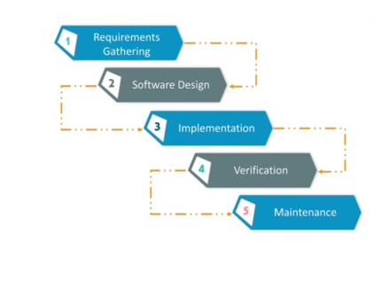
What WHY HOW Where to USE WHEN to USE
Waterfall Model
Business Scenario
[When to use]
Stable Requirements
Product scope is stable
Known Tech Stack
Resources pool Availability
Notes:
What is the Waterfall model?
The waterfall model is a model of software development that is pretty straight forward and a linear. This model follows a top-down approach. This model has various starting with Requirements gathering and analysis. This is the phase where you get the requirements from the client for developing an application. After this, you try to analyze these requirements. Next comes the Design phase where you prepare a blueprint of the software. In this phase, you think about how the software is actually going to look like. Once the design is ready, you proceed further with the Implementation phase where you begin with the coding for the application. The team of developers works together on various components of the application. Once the application is developed, it is tested in the verification phase. There are various tests conducted on the application such as unit testing, integration testing, performance testing, etc. After all the tests on the application are done, it is deployed onto the production servers. At last, comes the maintenance phase. In this phase, the application is monitored for performance. Any issues related to the performance of the application are resolved in this phase.
When to use the waterfall model
This model is used only when the requirements are very well known, clear and fixed.
Product definition is stable.
Technology is understood.
There are no ambiguous requirements.
Ample resources with required expertise are available freely.
The project is short.
Drawbacks –
This model however has few drawbacks such as follows:
This model was too time-consuming. Unless you complete a particular stage, you cannot proceed to the further stages.
This model was suitable only for projects where requirements are stable.
The working software is delivered only after completion of the final stage of the model.
It is very difficult to go back to the previous stages and make some changes that you had not thought about in the initial phase.

Slide 5
Why we are not using Waterfall model?
Open Discussion –
Inputs –
Scenarios –
What will work with waterfall model what will not work
Is waterfall model that bad?
Who are using waterfall model ?

Slide 6
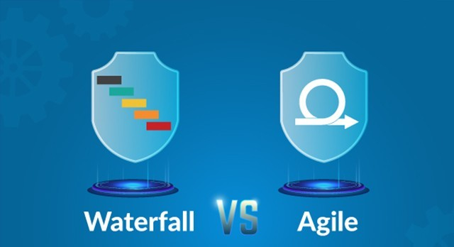
Waterfall vs Agile: Which One Should You Choose?
Business Scenario
[When to use AGILE ]
Incremental Requirements
Flux in development cycle
Test each solution
Working product
Self sustained team available
Implementation is less risky*
Notes:
What is Agile methodology?
Now let us try to understand What exactly is Agile. Agile Software development is an approach under which requirements and solutions evolve through the collaborative effort of self-organizing and cross-functional teams and their customer(s)/end user(s). It advocates adaptive planning, evolutionary development, early delivery, and continual improvement, and it encourages rapid and flexible response to change.
When to use Agile model:
When new changes need to be implemented. ...
To implement a new feature the developers, need to lose only the work of a few days, or even only hours, to roll back and implement it.
Unlike the waterfall model in agile model very limited planning is required to get started with the project.
So in Agile, you release the application with some high priority features in the first iteration. After its release, the end-users or the customers give you feedback about the performance of the application. The necessary changes are made into the application along with some new features and the application is again released which is the second iteration. This procedure is repeated until the desired software quality is achieved.

Slide 7
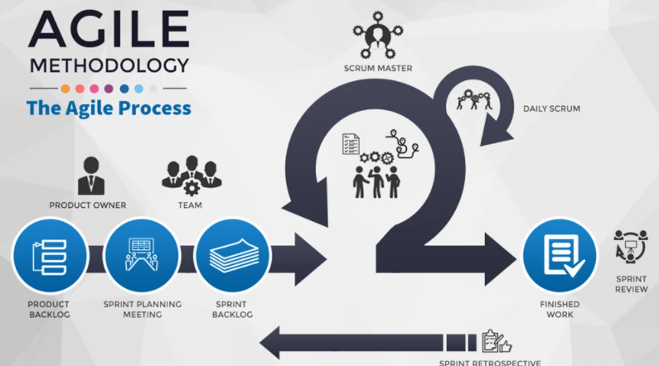
What is agile methodology [scrum]
●
Business Scenario
[why to use AGILE ]
Improve Customer Involvement
Increase Quality
Simplify releases
Incremental Requirements
Working product
Implementation is less risky* , cost & time effective
Notes:
Agile is an iterative based software development approach where the software project is broken down into various iterations or sprints. Every iteration has phases like the waterfall model such as requirements gathering, design, development, testing, and maintenance. The duration of each iteration is generally 2–8 weeks.
The agile method anticipates change and allows for much more flexibility than traditional methods. Clients can make small objective changes without huge amendments to the budget or schedule. ... This method saves the client money and time because the client tests and approves the product at each step of development.
It is a lightweight development method and they were also able to give wordings for the same in the form of a manifesto. It was called “ The Manifesto for Agile Software Development”. This manifesto contains 4 Values and 12 principles.

Slide 8
Agile development [scrum] – deep dive – how does it work
You make a list:
Sitting down with your customer you make a list of features they would like to see in their software. We call these things user stories and they become the To Do list for your project.
You size things up:
You size(estimate) your stories relatively to each other, coming up with a guess as to how long you think each user story will take.
You set some priorities:
Like most lists, there always seems to be more to do than time allows. So you ask your customer to prioritize their list so you get the most important stuff done first, and save the least important for last.
Notes:
Agile is a time boxed, iterative approach to software delivery that builds software incrementally from the start of the project, instead of trying to deliver it all at once near the end. It works by breaking projects down into little bits of user functionality called user stories, prioritizing them, and then continuously delivering them in short two-week cycles called iterations.

Slide 9
Agile development [scrum] – deep dive – how does it work
Then you start delivering some value. You start at the top. Work your way to the bottom. Building, iterating, and getting feedback from your customer as you go.
You update the plan as you go :
Then as you and your customer starting delivering one of two things is going to happen. You'll discover:
You're going fast enough. All is good. Or,
You have too much to do and not enough time.
At this point you have two choices. You can either a) do less and cut scope (recommended). Or you can b) push out the date and ask for more money.
●
●
Notes:
Agile software development allows the team to work together more efficiently and effectively to develop complex projects. It consists of practices that exercise iterative and incremental techniques that are easily adopted and display great results.
The 4 values of the Agile Manifesto are as follows:
1. Individuals and interactions over processes and tools
2. Working Software over comprehensive documentation
3. Customer collaboration over contract negotiation
4. Responding to Change over following a plan
The 12 principles that are mentioned in the Agile Manifesto are as follows:
Customer satisfaction by early and continuous delivery of valuable software.
Welcome changing requirements, even in late development.
Deliver working software frequently (weeks rather than months)
Close, daily cooperation between business, people and developers
Projects are built around motivated individuals, who should be trusted
A face-to-face conversation is the best form of communication (co-location)
Working software is the primary measure of progress
Sustainable development, able to maintain a constant pace
Continuous attention to technical excellence and good design
Simplicity-the art of maximizing the amount of work not done-is essential
Best architectures, requirements, and designs emerge from self-organizing teams
Regularly, the team reflects on how to become more effective and adjusts accordingly

Slide 10
Advantages of Agile model:
Customer satisfaction by rapid, continuous delivery of useful software.
People and interactions are emphasized rather than process and tools. Customers, developers and testers constantly interact with each other.
Working software is delivered frequently (weeks rather than months). Face-to-face conversation is the best form of communication.
Close, daily cooperation between business people and developers. Continuous attention to technical excellence and good design.
Regular adaptation to changing circumstances.
Even late changes in requirements are welcomed

Slide 11
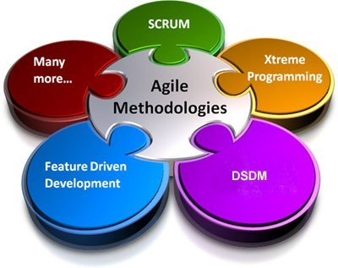
Agile Methodologies
●
Scrum
Extreme Programming (XP)
Dynamic Systems Development Method (DSDM)
Feature-Driven Development (FDD)
Lean and Kanban Software Development
Crystal
Notes:
The Scrum framework addresses two critical pain points of software development. First is the speed of software development and the second is client requirements which keep on changing. In this approach, the software development project is executed in phases and each phase known as a Sprint. Also, small teams of 5–6 members are created, who collectively work towards the desired results.
The Scrum methodology allows active client participation at each stage so that any required changes are addressed immediately and acted on. This ensures that the project is delivered within time and meets the client demands effectively.
XP is the most successful method of developing agile software because of its focus on customer satisfaction. XP requires maximum customer interaction to develop the software. It divides the entire software development life cycle into several numbers of short development cycles. It welcomes and incorporates changes or requirements from the customers at any phase of the development life cycle.
Extreme programming starts with collecting user requirements. Depending upon these requirements the whole development process is divided into several small numbers of cycles. So the next phase is iteration planning i.e. deciding the no of cycles, prioritizing the requirements and estimating the amount of effort required to implement each cycle.
Now each iteration is developed using pair programming. During the development phase, new user requirements may come and the iteration plan should be adjusted according to that. The next step is to test the latest developed version for bugs if detected; the bugs will be removed in the next iteration. After every acceptance testing project tracing should be done in which feedback is taken from the project that how many jobs have already been done. XP has introduced many new things for developers like pair programming, extensive code review, code refactoring, and open workspace.
An engineer from Toyota called Taiichi Ohno invented the Kanban framework. Somewhere around the late 1940s, the representatives of Toyota company observed how supermarkets restock their goods based on what has been picked off the shelves. So Toyota came up with a system where actual consumption drives the production plans.
One of the core ideas of Kanban is to refrain from producing a surplus. This is achieved by making use of Kanban cards and a Kanban board. They are also used to visualize the flow of resources throughout the production cycle. This gives everyone maximum insight into the process. This also helps managers address whatever the surplus or the shortage is in real time.
The Kanban system also introduces the notion of “pull” over “push,” meaning that workers pull in work according to their capacity, as opposed to work being fed to them on a conveyor belt or in the form of a to-do list.
Lean
This method of software development is based on the principle “Just in time production”. The aim of Lean is to increase the speed of software development and to reduce its cost. The seven steps to summarize Lean development are as follows:
Delete unnecessary things (everything that does not bring effective value to the customer’s project is deleted);
Quality development (creating quality in development requires discipline and control of the number of residuals created);
Create Knowledge (the team is motivated to document the whole infrastructure to later retain that value);
Differing commitments (this point encourages the team not to focus too much on planning and anticipating ideas without having a prior and complete understanding of the requirements of the business);
Fast delivery (deliver value to the customer as soon as possible);
Respecting the team(communicating and managing conflicts are two essential points);
Optimize the whole (the development sequence has to be perfected enough to be able to delete errors in the code, in order to create a flow of true value).
Crystal Methods are a family of software development methodologies. Alistair Cockburn developed these methods from his study and interviews with teams. The color-coded methods signify the risk to human life. For example, projects that may involve risk to human life will use Crystal Sapphire while projects that do not have such risks will use Crystal Clear.
Crystal focuses on six primary aspects: people, interaction, community, communication, skills, and talents. Consider the process as secondary. There are also seven common properties in Crystal that indicate a higher possibility of success and they include frequent delivery, reflective improvement, osmotic communication, and easy access to expert users.
The methods are very flexible and avoid rigid processes because of their human- powered or people-centric focus. Alistair Cockburn is also one of the original signatories of the Agile Manifesto.
Crystal Methods consider people as the most important, so processes should be modeled to meet the requirements of the team. It is adaptive, without a set of prescribed tools and techniques. It is also lightweight, without too much documentation, management or reporting.
The project environment and team size determine the weight of the methodology. For example, Crystal Clear is for short-term projects by a team of 6 developers working out of a single workspace

Slide 12
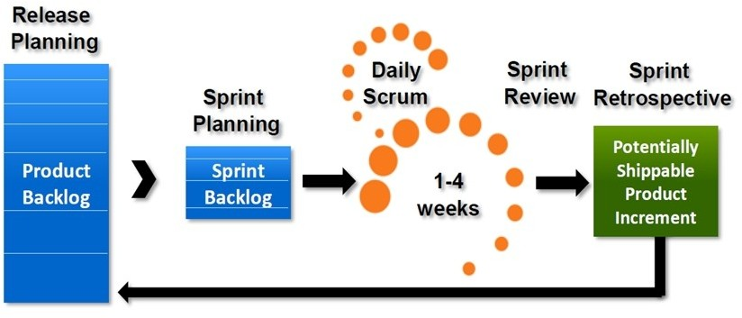
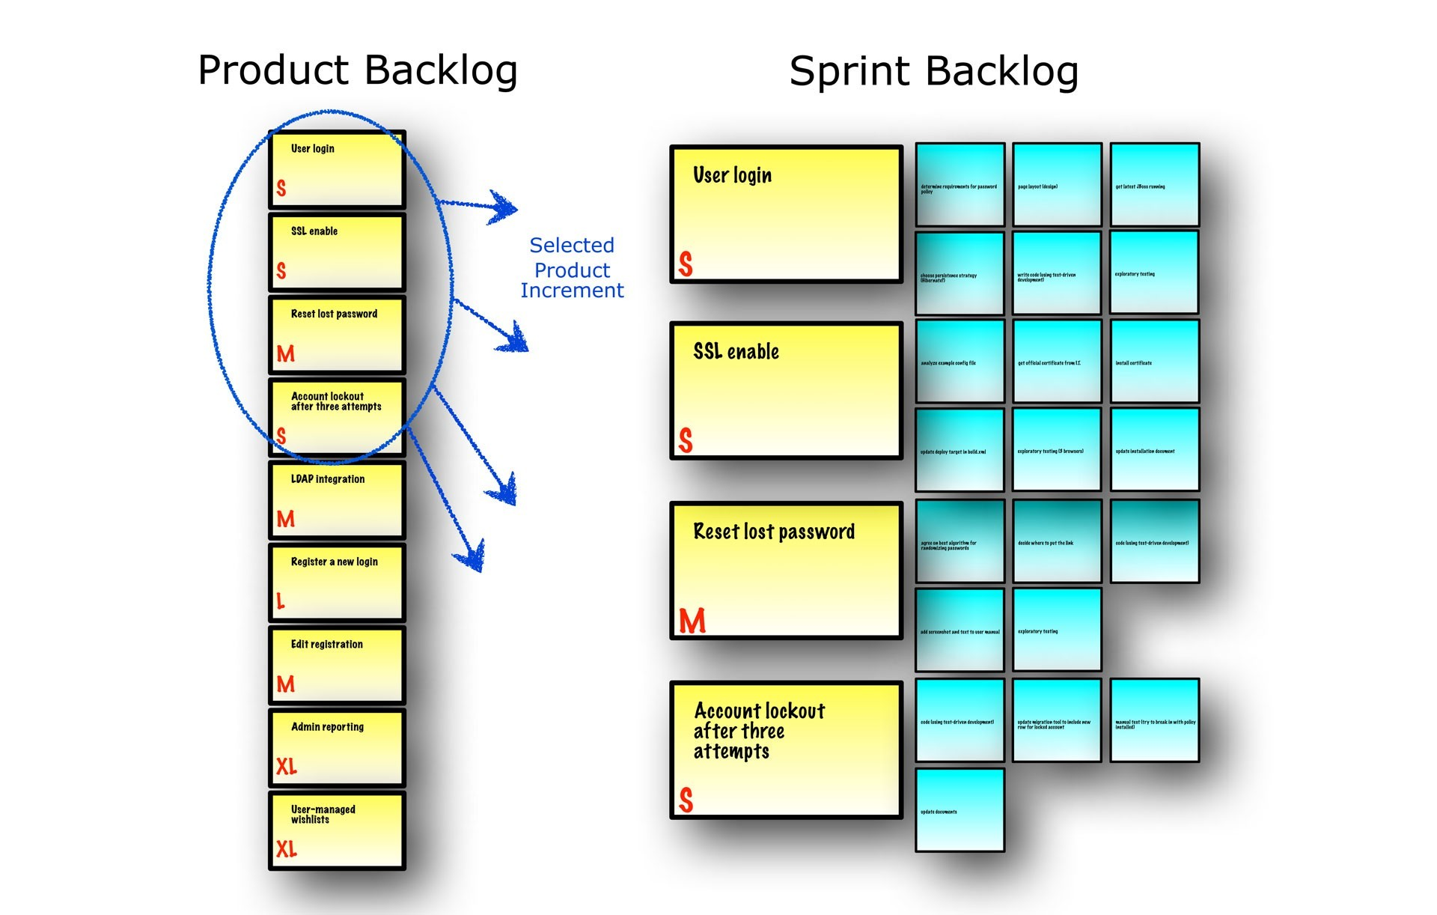
SCRUM PROCESS
sprint planning

Slide 13
Disadvantages of Agile model:
●
In case of some software deliverables, especially the large ones, it is difficult to assess the effort required at the beginning of the software development life cycle.
The project can easily get taken off track if the customer representative is not clear what final outcome that they want.
Only senior programmers are capable of taking the kind of decisions required during the development process. Hence it has no place for newbie programmers, unless combined with experienced resources.
Teams get easily sidetracked due to lack of processes. ...
Long-term projects suffer from incremental delivery. ...
The level of collaboration can be difficult to maintain
Notes:
Pros and Cons of Agile
Pros
Because of the high customer involvement, you receive feedback quickly and make decisions on the fly. There’s more frequent communication, more feedback and a closer relationship with your customers.
There is a lesser risk since your work output is reviewed at every stage. You also save money and time from unnecessary expenditures, because you’ll be prioritizing providing value for your users.
You’ll be improving the quality of your output with each cycle. By breaking down your project into bite-sized pieces, you learn from each iteration. There is a lot of trial and error involved, but for the most part, you’re still focusing on high-quality development, testing, and collaboration.
Cons
For the approach to work, all members of the team must be completely dedicated to the project. Everyone must be involved equally if you want the whole team to learn
Here are the three disadvantages of Agile methodology all project managers ultimately face.
Teams get easily sidetracked due to lack of processes. ...
Long-term projects suffer from incremental delivery. ...
The level of collaboration can be difficult to maintain

Slide 14
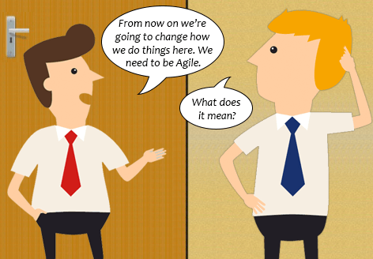
ASSESSMENT Time – Scenario 1 – 5 to 7 Min
1. Provide detailed inputs with analysis –
If Agile way of working will be successful here or not
What changes you would suggest as a Team member/Leader/Manager to have a sacksful working product delivered?
Workaround [If Any] ?

Slide 15

ASSESSMENT Time – Scenario 2 – 5 to 7 Min
1. Provide detailed inputs with analysis –
If Agile way of working will be successful here or not
What changes you would suggest as a Team member/Leader/Manager to have a sacksful working product delivered?
Workaround [If any] ?

Slide 16
Using Agile Tools – Quick Demo
JIRA on Cloud - https://team-1606820906101.atlassian.net/secure/BrowseProjects.jspa
Jile - https://t11621.jile.io/app/WS1/sre-demo/home

Slide 17
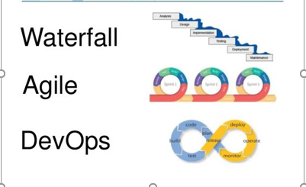
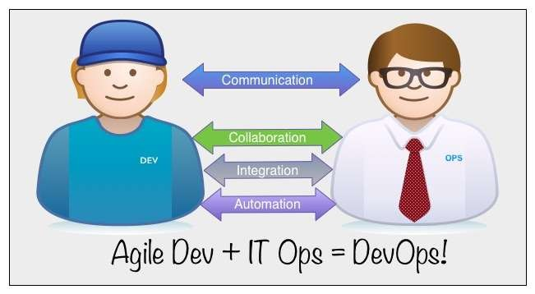
The Agile in DevOps!
Notes:
Agile & DevOps -
Similarities: Both designed to improve quality and increase business productivity
Promotes shared responsibilities
Customer-focused development
Faster software delivery and flexibility
While Devops targets more deployment and collaboration, agile mainly focuses on project management to develop software faster.
Agile makes development cycles more efficient and DevOps enables ‘Continuous Everything’ culture.
Agile-backed DevOps is popular among organizations to leverage Agile’s faster development and DevOps’s faster deployment to build software.
Both can work together to maintain software quality and speed.
Agile enables DevOps culture to innovate and deploy faster.

Slide 18
What’s it All About – DevOps?
DevOps implementations are increasing dramatically
But there are many differences between the practices and goals among users.
What should DevOps accomplish? Who is it for?
Is it just for enterprise? Enterprise with agile development practices?
Should companies with service applications (SaaS and other network-based apps) be using DevOps?
Is it only for apps with continuous support and updates or should every app pass through DevOps systems?

Slide 19
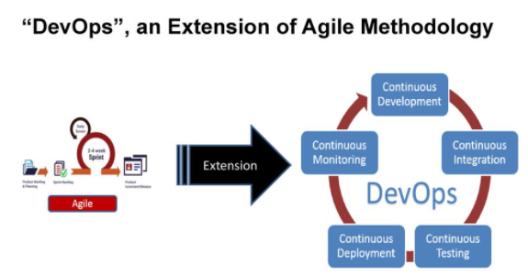
Devops Culture – Development + Operations
Business Scenario
Improved operational support and faster fixes.
Good processes across IT and teams, including automation.
Increased team flexibility and agility.
Happier, more engaged teams.
Cross-skilling, self-improvement.
Collaborative working.
Respect from senior management.
Notes:
Both Agile and DevOps are utilized in the software development process. As it is a long and arduous process, multiple components requires to be developed simultaneously within a short deadline. Lots of planning goes into this even before the development starts, such as deciding the approach to the whole process, explaining the tasks involved, and identifying the people to be included. Apart from this, setting the deadline and providing the benchmark of assessment is some other major components in the development process that reduce the time-to-market aspect of the final product. To approach all this and comfortably plan out the software development life cycle. The best approach is to use both Agile and DevOps together so that the characteristics of both concepts come into play in solving a problem in the process as well as the organization. Making use of both concepts adds to higher levels of flexibility in the process and realizes the fact that there is no specific solution to solve all the needs within an organization.
Agile and DevOps are two different software development methodologies having a similar goal — to build software faster with maximum efficiency.
Agile is an approach to software development for developing high-quality software frequently in an iterative manner.
DevOps is considered as a logical continuation of the Agile journey. DevOps represents a work culture to bridge a gap between development and operations teams to shorten the development time and build high-quality software.

Slide 20
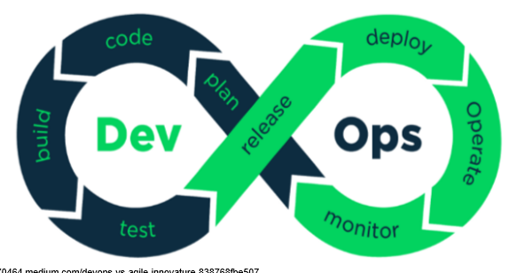
DevOps – Deep Dive
DevOps is a software development method in which the IT professionals collaborate among themselves focusing on communication and integration to enable rapid deployment of products.
The Collaboration between development and operations teams are promoted in DevOps culture. This results in an efficient, speedy and automated deployment of code to production. It helps to increase the delivery speed of an organization. As the name indicates, it is a collaboration between development and IT operations.

Slide 21
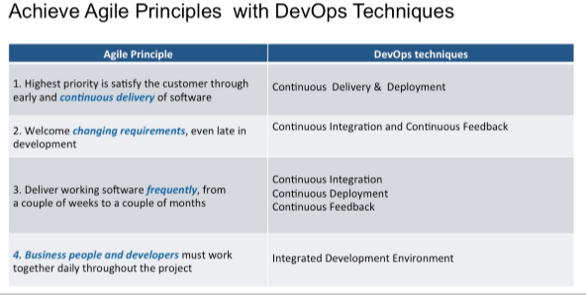
Advantages of DevOps Culture in Agile Organizations
Notes:
The advantages of DevOps
By creating a more dynamic development ecosystem that is primarily focused on the exact business objectives which avoid human error from the project lifecycle,
DevOps enables organizations to:
Reduce the implementation time of new services from months to minutes.
Increase the productivity of a business and IT teams.
Save costs on maintenance and upgrades and eliminate unnecessary capital expenditure.
Standardize processes for easy replication and faster delivery.
Improve quality, reliability and reusability of all system components.
Increase the rate of success for digitalization strategies and transformation projects.
Ensure that money invested in cloud infrastructure, analytics and data management is not wasted.
DevOps is the ideal approach for government IT projects and for large scale private implementations as it delivers the value in much early phase of the project lifecycle. It provides continuous improvement and operational flexibility which helps accelerate new services, providing innovative and cost-effective ways for delivering value through updated ways of development and operations.

Slide 22
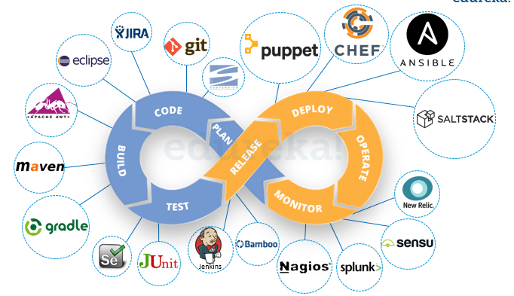
DevOps Tools & Phases
DevOps Phases
Continuous Development
Continuous Testing
CI(Continuous Integration)
CD(Continuous Deployment)
Continuous Monitoring
Notes:
The above image shows the various sub-stages of DevOps and the tools used in each of them. Each of the tools in DevOps is bound to a particular phase of DevOps. Now let us discuss the phases of DevOps and the tool that is used in that phase. All of these phases together constitute the DevOps lifecycle.

Slide 23
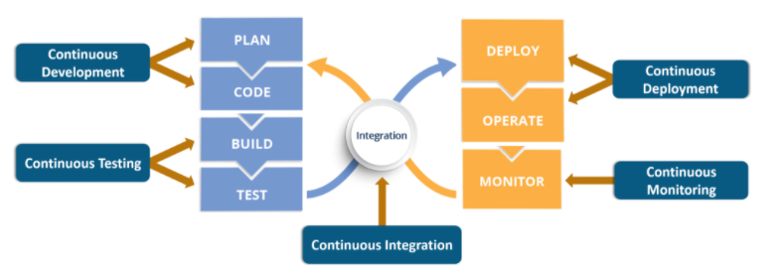
DevOps – CI CD Pipeline
Phase 4 : Continuous Deployment
Tools Used:
CM Tools – Chef, Puppet, Ansible, SaltStack Containerization – Docker, Vagrant, Kubernetes
Phase 1: Continuous Development
Tools used: Git, SVN, CVS, JIRA, BitBucket
Phase 2: Continuous Integration
Tools: Jenkins, TeamCity, Travis, GitLab CI
Phase 3: Continuous Testing
Tools used: Jenkins, Selenium TestNG, JUnit
Phase 5: Continuous Monitoring
Tools Used: Splunk, ELK Stack, Nagios, New Relic
Notes:
DevOps integrates developers and operations team to improve collaboration and productivity.
According to the DevOps culture, a single group of Engineers (developers, system admins, QA’s. Testers etc. turned into DevOps Engineers) has end to end responsibility of the Application (Software) right from gathering the requirement to development, to testing, to infrastructure deployment, to application deployment and finally monitoring & gathering feedback from the end-users, then again implementing the changes.
This is a never-ending cycle, and the logo of DevOps makes perfect sense to me. Just look at the above diagram

Slide 24
Nuts & Bolts – Deployment Pipeline
The primary characteristic of DevOps – continuous delivery system to bring new features & software updates to the end user
Includes all the people, principles, processes and tools required in a flexible, repeatable, automated system
Scale depends on the size of the organization and the complexity of the software stacks involved

Slide 25

Deployment Pipeline
Production-equivalent staging environment
Development staging as close as possible to production
configuration
Include all aspects necessary – version control, continuous integration, test frameworks, configuration management, etc. in the build system
Flat, integrated development and production test environments
Insure testing environments in dev and for production are as closely matched as possible
Entire DevOps team needs to participate in prorogating configuration and specifications forward and backward across all environments in pipeline

Slide 26
Deployment Pipeline
Deploy to staging every iteration with deployment to production frequently
Deployment to staging improves confidence that releases will pass through to production successfully
It may not be possible to release every iteration to production.
Delays may be necessary to assure full feature sets are released in context for users to make use of or to allow evaluations of security and regulatory issues or market impacts
End to end version control
Manage all the artifacts, metadata, supporting configuration and test data

Slide 27
Deployment Pipeline
Automated builds for new environments
Use virtualization, tools and scripts to automate the implementation of new environments and lower the risks of manual implementations. Quick and consistent implementations are key.
Automated deployment to production
Avoid the risks and inconsistencies of manual processes and passed responsibilities between silos as much as possible.
Getting all stakeholders on board and to loosen their grip on processes to allow them to be automated is not light work – but it is necessary to reach the goal
Consistency, don’t lose momentum in the pipeline

Slide 28

ASSESSMENT Time – Scenario 2 – 5 to 7 Min
1. Provide detailed inputs with analysis –
If DevOps way of working will be successful here or not
What changes you would suggest as a Team member/Leader/Manager to have a sacksful working product delivered?
Workaround [If any] ?

Slide 29

ASSESSMENT Time – Scenario 1 – 5 to 7 Min
1. Provide detailed inputs with analysis –
If DevOps Culture of working will be successful here or not
What changes you would suggest as a Team member/Leader/Manager to have a sacksful working product delivered?
Workaround [If any] ?

Slide 30
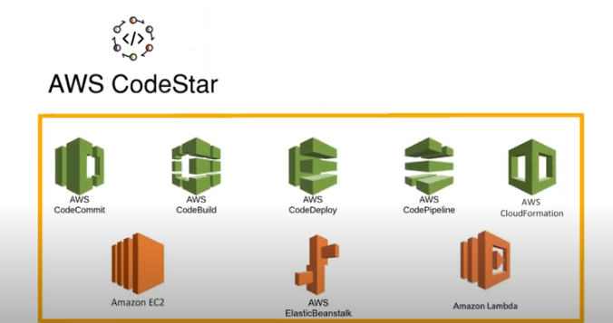
Using CI CD Pipeline
AWS CodeStar
Azure DevOps

Slide 31
Devops Challenges [Why a DevOps Organization Fails]
Focusing too much on the tools and the automation
Trying to go faster to deliver more value
Not continuously improving
Missing Security Cover
Not being honest about your progress
Assuming that change is easy
Devops ++ ? How we save our Devops Culture/PRACTICE?W DevOps Organization Fails]
Notes:
Reasons Behind DevOps Failure:
Lack of ‘DevOps’ culture in the organization
DevOps are not defined in line with business goals
Automation and speed are over-expected
People are not involved in the process
Inappropriate Infrastructure and DevOps toolchain
Lack of collaboration between teams
The primary aim of DevOps is to automate processes of delivering and deploying software, but organizations often forget that DevOps is more about culture and people, not just for rapid delivery.
Every organization has its different set of DevOps scopes, depending upon the business objectives. To implement DevOps successfully, an organization must define DevOps framework along with the right mindset, updated tools, and collaborative environment.

